Slide 1
RadSummarizer - Automating Radiology Report Summarization Using NLP
Group Mates
Hamna Imran
Muhammad Ibrahim Kashif

Slide 2
Scope & Impact
Problem Statement:
Manual summarization is inefficient and may delay clinical decisions.
Proposed Solution:
Develop an NLP-based system to generate concise summaries of radiology reports automatically.
Impact:
- Reduces clinicians' workload
- Saves time in emergency care
- Improves healthcare communication
- Supports integration into medical IT systems

Slide 3
NLP Methodology
Approach:
- Use pre-trained abstractive summarization model (BART)
- Fine-tune if required on domain-specific data
Pipeline:
- Preprocess input text
- Generate summaries using model
- Evaluate summaries using ROUGE and BLEU scores
Tools:
- Python, HuggingFace Transformers

Slide 4
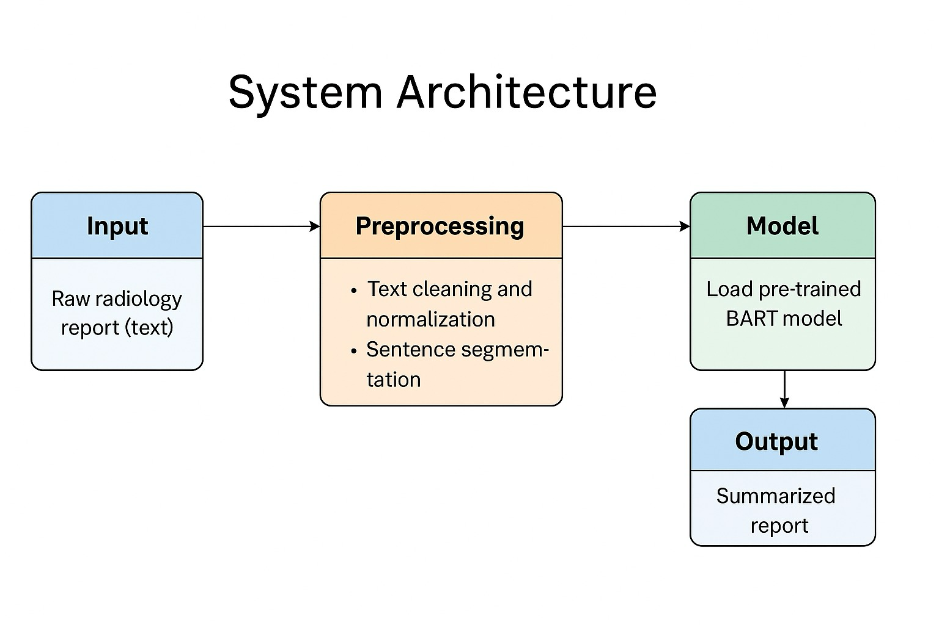

Slide 5
Expected Outcomes
Results Anticipated:
- Accurate, concise summaries for unseen reports
-Use Case:
- Assisting clinicians with quick report understanding
- Enhancing radiology software solutions

Slide 6
Challenges
- Handling domain-specific language
- Maintaining factual accuracy in summaries
- Small dataset size may limit model performance

Slide 7
Thank You
Questions?

